Slide 1
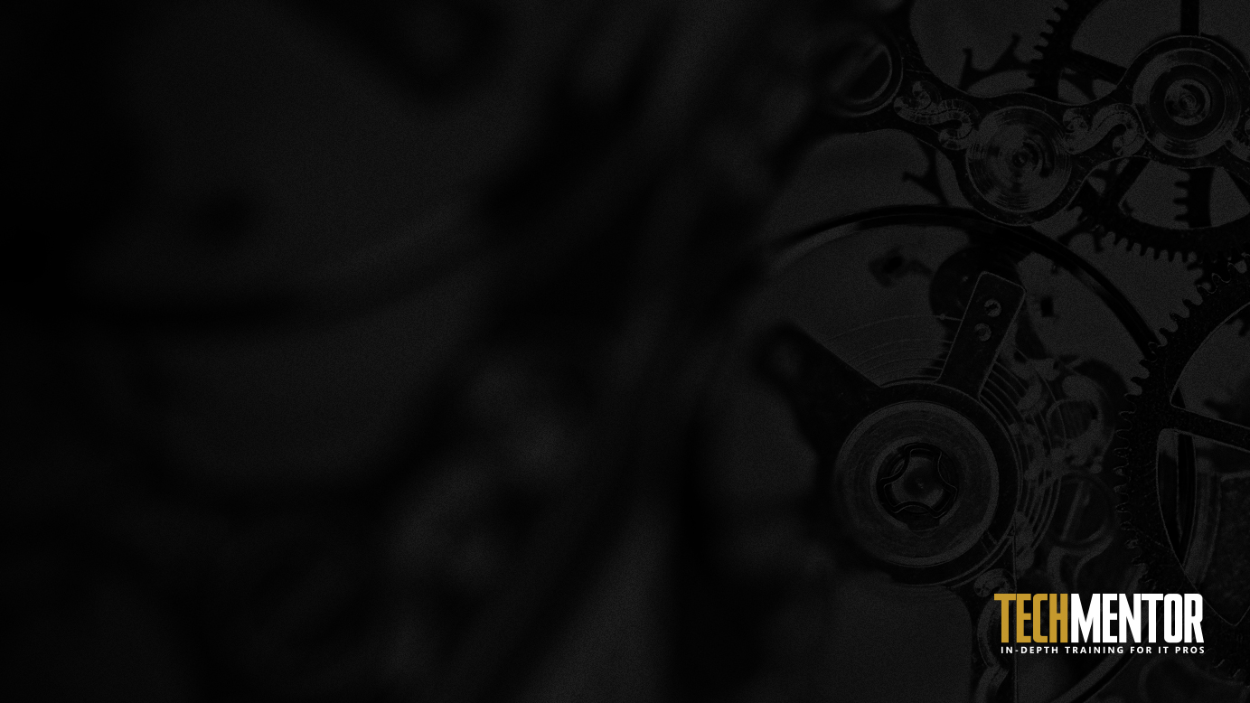
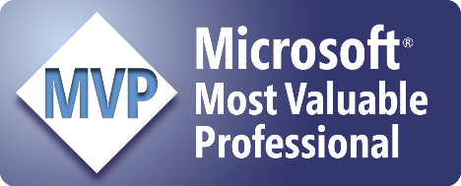
Automating Software Installs with PowerShell
Adam Bertram
PowerShell MVP
Notes:
Have you ever…
How’d you approach it? Did you use the same methodology as a similar piece of software?
That is what this talk is all about

Slide 2

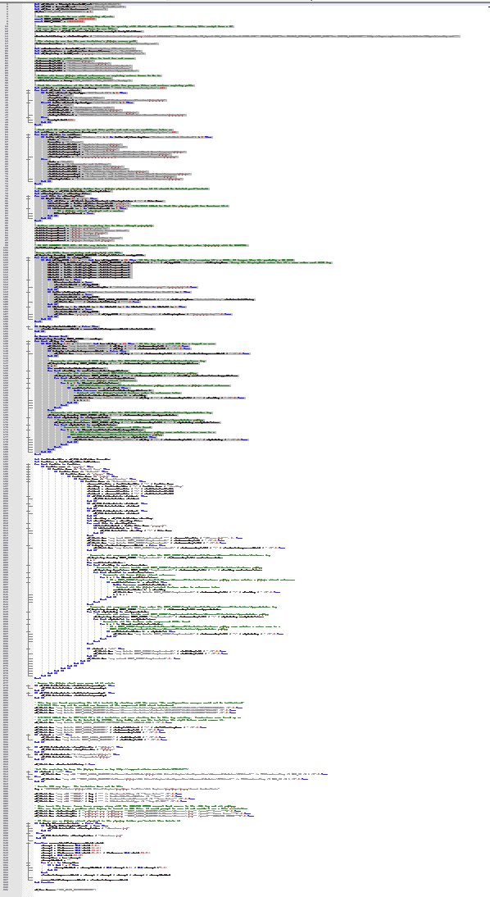
The 100 Hour Week
What on earth would require 100 hours in a week?
It rhymes with “itrix”
Lots of config differences
Helpdesk calls (My icon!)
Finance is down!
Kill me now!
Sleep
Boss: WTF? Me: Yep
Notes:
Anyone worked 100 hours in a week? …was it what you’d consider fun?
Application that rhymes with itrix that needed upgraded enterprise-wide from 12.4 to 13.
This app required different configurations whether it was a thin client, x86/x64, desktop, etc.
Citrix admin comes up to me on Friday..
Used the methodology for an old version and thought it’d work for the new version.
Pushed out to group on Monday evening..minor problems…fixed.
- Tested checking if in ARP and a single Citrix application..worked
Helpdesk calls about icon that’s changed the next day
Pushed out again on Tuesday evening..minor problems..fixed
Finance calls in a panic on Wednesday morning that their application won’t run.
- we didn’t test that application. It required another registry key to enable single sign on
The week continues like this until I eventually accumulated 100 hours
I was a consultant at the time for this client and my boss emailed me and said “did you make a typo on your timesheet”?
This could have been prevented if the versions didn’t change so much.

Slide 3
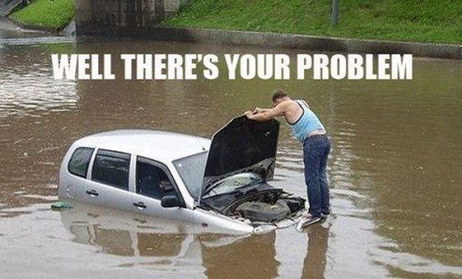
Well, There's Your Problem
Lack of Package Standardization
Hard to define “installed” and “uninstalled”
Post-install configuration needed
Cleanup work post-uninstall

Slide 4
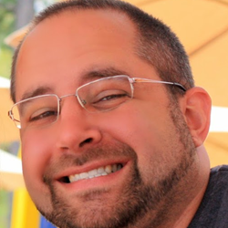
Whoami
PowerShell MVP
Consultant
Pluralsight Author (Free 1-Month Passes!)
Freelance Writer
Blog: adamtheautomator.com
Twitter: @adbertram

Slide 5
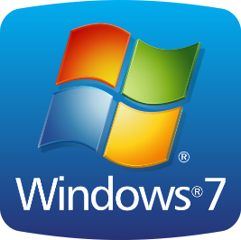
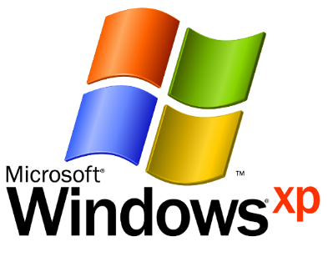

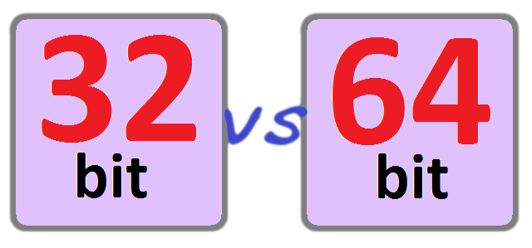
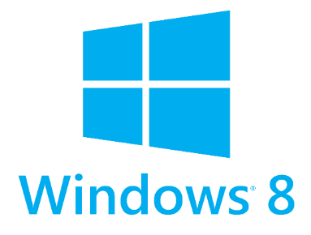
Is this Your Environment ?
Notes:
Does this look like your environment?
Who here has all Windows 8.1 and Server 2012 R2 only? …..are you hiring?
Each OS and architecture is different and needs to be accounted for.

Slide 6

Sorry, no Shiny things here
Nothing new and shiny
Git 'er Done Scenarios
What it takes to get the job done
Notes:
This talk is not going to concentrate on any new technology
We’re using native PowerShell code
- no PowerShell Package Manager
- no DSC

Slide 7
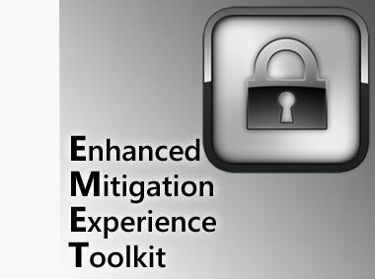
Demo: Deployment Walkthrough
Step-by-Step
Manual Deployment
Mimicking the Actual Launch Script
A Well-Behaved MSI with a dependency
Notes:
Taking the launch script’s activities step by step
- Manually showing each piece of the launch script and how it executes the deployments
Picked EMET because it’s easy (NOT the norm!). Can be installed with minimal effort with default methods

Slide 8
The Launching Script (A Poor Man's SCCM)
Server Tests
Client Tests
Client Monitor
Deploy
Cleanup
NOT needed if you have another tool

Slide 9

Demo: Adobe Reader
Windows Installer Package (MSI)
Two Deployments
Default Install First
Customizing Install with a TRANSFORMS (MST)

Slide 10
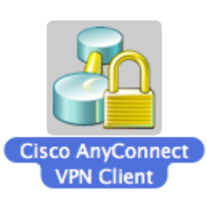
Demo: Cisco AnyConnect
Multiple MSIs at once
Using MSTs
Set-RegistryValueforAllUsers​
Notes:
Using the flexibility of a PowerShell script you can do anything you want
This does multiple MSIs in the same deployment with a MST
AnyConnect breaks out MSIs into different program functions
AnyConnect has connection notices that show up in the systray. A registry value prevents that

Slide 11
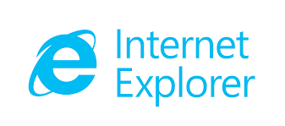
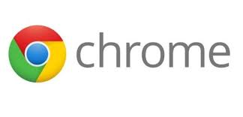



Demo: Web Apps Need Deployed?
Shortcuts, Oh My!
New-Shortcut

Slide 12
Demo: What's "Installed" Actually Mean?
Just in Programs and Features? Yeah, right.
Registry keys
File Locations
File Versions

Slide 13
Building useful logs
Easily consumable
Severity Levels
Verbose

Slide 14
Demo: Logging
Writing a Write-Log function
Log levels
Errors : Bad stuff
Warnings : Sorta bad stuff
Common : Normal stuff
Before and after events

Slide 15
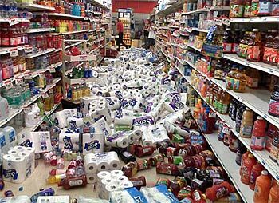
Automating Software Uninstalls
Cleanup on Aisle 5!
All About Detection and Removal
Cleaning up after vendors
Notes:
Unfortunately, not all (most!) applications clean up after themselves.
We have to pull install folders, registry stuff, files placed in AppData, temp folders, etc.
To develop a complete software deployment solution you must account for this stuff.
What’s also important is detecting both when you need to perform some manual intervention and when it’s removed

Slide 16
Demo: Web App Removal
APPS
No shortcut will be missed!

Slide 17

Demo: Adobe Reader Uninstall
Not so simple
Will fail if Reader is open
Leaves lingering AppData folder

Slide 18
Demo: Cisco AnyConnect Uninstall
Multiple MSI Uninstalls
Leaves folders and registry keys behind

Slide 19
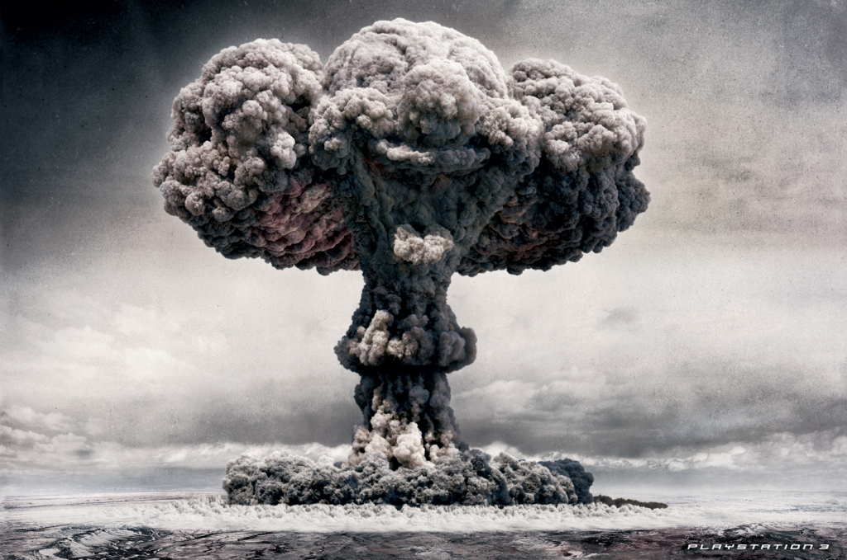
Stubborn Applications
Some apps really want to stay installed
You must go nuclear
MsiZap
Notes:
Healthcare applications..thinking it was a GE or a Siemens app that would not uninstall
Handle with care

Slide 20
Automating Software Upgrades
Upgrades are Hard
Detect
Uninstall (maybe)
Install
Detect

Slide 21
Demo: Adobe Reader Upgrade
Upgrading from v7 to v11
Requires using third party removal tools

Slide 22
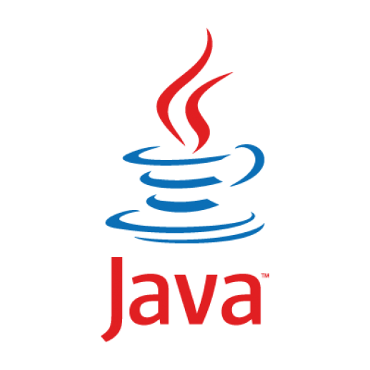
Demo: Java. Enough Said
New versions constantly
Horribly insecure
Multiple versions (at the same time!)
App dependencies on old versions
PITA
Did I mention PITA?

Slide 23
Your Job is Never Done
This isn’t perfect
Software vendors will keep being software vendors
Contribute!

